Slide 1
[ALT]
Smart3 VE Consideration items
(Components changing)
Organization
R&D Lab. 2
Issued Date
2023.05.17
Version
1.1

Slide 2
Revision History
Version | Date | Description | Owner
1.0 | 2023/04/26 | 1st Draft version | Lonnie Kim
1.1 | 2023/05/17 | Updated 2nd source based on FII feedback | Lonnie Kim

Slide 3
Each item’s 2nd Source

Slide 4
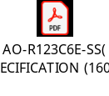
Front I/O Components
Item | Original Part | Original Part |  |  | Alternative Part |  | Consideration Point
 | Part Name | Manufacture | Part reference | Quantity | Part Name | Manufacture
IR Sensor | TSOP75338TR | Vishay | U402 | 1 | AO-R123C6E-SS(S) | AUK | 1. IR Test
 |  |  |  |  | IRM-V838J12-S/TR1(KU)(HFX) | Everlight | ALT request to datasheet to FII(5/170
LED | 19-137/R6GHBHC-C01/2T | Everlight | LD1301 | 1 | LG-197GBR-CT-3C2 | LIGITEK

Slide 5
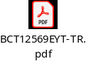
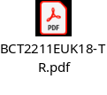

Power Components
Item | Original Part | Original Part |  |  | Alternative Part |  | Consideration Point
 | Part Name | Manufacture | Part reference | Quantity | Part Name | Manufacture
DC/DC | AP61302Z6-7 | Diodes | U301, U302, U304, U305 | 4 | BCT12569EYT-TR | Broadchip | EMI/EMC Power test
LDO | TPL740F18-5TR | 3Peak | U303, U306 | 2 | BCT2211EUK18-TR | Broadchip | 1. Power test
LDO | TPL740F25-5TR | 3Peak | U307 | 1 | BCT2211EUK25-TR | Broadchip | 1. Power test
LDO | TPL740F25-5TR | 3Peak | U307 | 1 | TMI6050-25 | TMI SUNTO

Slide 6
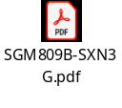

IC Components
Item | Original Part | Original Part |  |  | Alternative Part |  | Consideration Point
 | Part Name | Manufacture | Part reference | Quantity | Part Name | Manufacture
Reset | TPV809S-3TR | 3Peak | U401 | 1 | SGM809B-SXN3G | SGMicro | Reset timing
USB Power S/W | FP6861E-A1S6CTR | Fitipower | U902, U1401 | 2 | ET2016B | ETek | USB Power test For setting current limit to 1A, Rset(R902) shall change to 55Kohm 1%.(5/17)

Slide 7
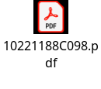
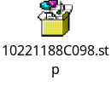
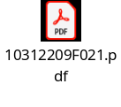
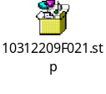
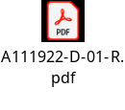
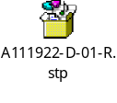
Connector Components
Item | Original Part | Original Part |  |  | Alternative Part |  | Consideration Point
 | Part Name | Manufacture | Part reference | Quantity | Part Name | Manufacture
RJ-45 Connector | JMP1N01-RA117-4F | Foxconn | J801 | 1 | 10221188C097 | CNS
RJ-45 Connector | JMP1N01-RA117-4F | Foxconn | J801 | 1 | 10221188C098 | CNS | Stp file:
USB3.0 Connector | UEA3119C-4FB1-4F | Foxconn | J901 | 1 | 10312209F021 | CNS | Stp file:
HDMI Connector | QJ51191-LFB4-7F | Foxconn | J1401 | 1 | A111922-D-01-R | CNS | Stp file:

Slide 8
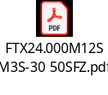
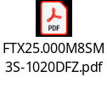
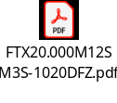
Crystal Components
Item | Original Part | Original Part |  |  | Alternative Part |  | Consideration Point
 | Part Name | Manufacture | Part reference | Quantity | Part Name | Manufacture
X-tal | E3SB24E00005JE | Hosonic | Y401 | 1 | FTX24.000M12SM3S-30/50SFZ | Chip Sun Tech | X-tal matching test
X-tal | E3SB25.0000F18G11 | Hosonic | Y801 | 1 | FTX25.000M8SM3S-50SFZ | Chip Sun Tech | X-tal matching test
X-tal | E3SB25.0000F18G11 | Hosonic | Y801 | 1 | FTX25.000M8SM3S-1020DFZ | Chip Sun Tech | X-tal matching test
X-tal | 8Z20072001 | TXC | Y1001 | 1 | FTX20.000M8R2SM3S-30SFZ | Chip Sun Tech | X-tal matching test
X-tal | 8Z20072001 | TXC | Y1001 | 1 | FTX20.000M12SM3S-1020DFZ | Chip Sun Tech | X-tal matching test

Slide 9


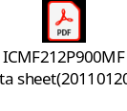
Inductor/Bead/CM Filter Components
Item | Original Part | Original Part |  |  | Alternative Part |  | Consideration Point
 | Part Name | Manufacture | Part reference | Quantity | Part Name | Manufacture
Inductor | DFE252010F-2R2M# | Murata | L301, L302, L303, L304, L801 | 5 | SWIPP252012-2R2 | Todaisu
Inductor | BLM15AG121SN1J | Murata | L1001 | 1 | MHC1005S121MBP | Inpaq
Chip bead | BBPY00160808121Y00 | Maglayers | L305, L306, L307, L308 | 4 | MHC1608S121NBP | Inpaq
Chip bead | BBPY00160808121Y00 | Maglayers | L305, L306, L307, L308 | 4 | MHC1608S121PBP | Inpaq | 1., Correct part no. is MHC1608S121PBP(2.5A)
CM Filters | MCU-201212H-900-E1 | Maglayers | L901, L902, L903 | 3 | ICMF212P900MFR | Innochips | 1. ALT confirmed ICMF212P900MFR can use USB3.0 line.

Slide 10
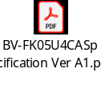
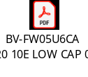
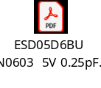

ESD Protection Components
Item | Original Part | Original Part |  |  | Alternative Part |  | Consideration Point
 | Part Name | Manufacture | Part reference | Quantity | Part Name | Manufacture
ESD Protection | IP4283CZ10-TBA | Nexperia | U1402 | 1 | BV-FK05U4CA | MDD
ESD Protection | AZ1065-06F.R7G | Amazing | D901 | 1 | BV-FW05U6CA | Bencent
ESD Protection | Rclamp3331ZATFT | Semtech | D1102 | 1 | ESD05D6BU | MDD
Varistor | TVM0G5R5M411R | Thinking | RV301, RV902, RV1401 | 3 | ICVS0505481FR | Innochips

Slide 11

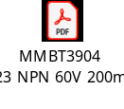

Other Components
Item | Original Part | Original Part |  |  | Alternative Part |  | Consideration Point
 | Part Name | Manufacture | Part reference | Quantity | Part Name | Manufacture
Transformer | LG1P109RN LF | Bothhand | T801 | 1 | PG18104 | East Ever
TR | MMBT3904-7-F | Diodes | Q1001, Q1002, Q1003 | 3 | MMBT3904 | MDD
FET | DMN26D0UT-7 | Diodes | Q1401 | 1 | WM02N08L | Wayon | 1. Q1401 was applied CEC line(not high speed line), so CISS might not affect timing issue.

Slide 12
Thank you.

